Slide 1
Achieving A Sustainable Future Together:
The Future of District Energy for Achieving Carbon Reduction Goals
Connect with us.
Count on us.
Thrive alongside us.
Matt O’Malley
Chief Sustainability Officer
February 8, 2023

Slide 2

Leveraging Existing Infrastructure, New Technologies and Renewable Energy Sources to Decarbonize the Building-energy Sector
District Energy has a 100-year history of greening and Vicinity will deploy innovative technologies to achieve net zero carbon emissions by 2050... Cutting our emissions in half by 2035
Boilers
CHP
~1900
~1950
~1990
~2000
2021
2022 – 2030
2030 – 2050
Coal
Oil
Natural
Gas
Combined Heat and Power (CHP)
Biogenic
Fuel
Electrified steam generation, industrial scale heat pumps, and long-term energy storage (electric/thermal) for carbon-based dispatch
Hydrogen, RNG and other fuels/technologies as they become available

Slide 3

The Kansas City District Energy Network
District energy saves over 33,000 tons of carbon emissions annually for Kansas City
Over 110 years of energy experience in Kansas City
4 million square feet (60+ Customers) of commercial space served
  T-Mobile Center
  City Hall
  KC Convention Center
  Flashcube Apartments
  Lifted Spirits Distillery
6+ miles of underground piping distribution for steam
and 4+ miles for chilled water
5MW Cogeneration capacity
99.99% reliable energy delivery
Net zero carbon emissions commitment by 2050 or sooner!
“I recommend Vicinity for three reasons: Reliability. Reduced maintenance costs. And it makes budgeting simpler with no unexpected replacement costs or capital expenditures... We have buildings that use electric, some gas, others use steam for heating. When we compare costs among our facilities, Vicinity’s steam is by far the most economical.”- Tom Corso, VP of Operations, MC Realty Group

Slide 4
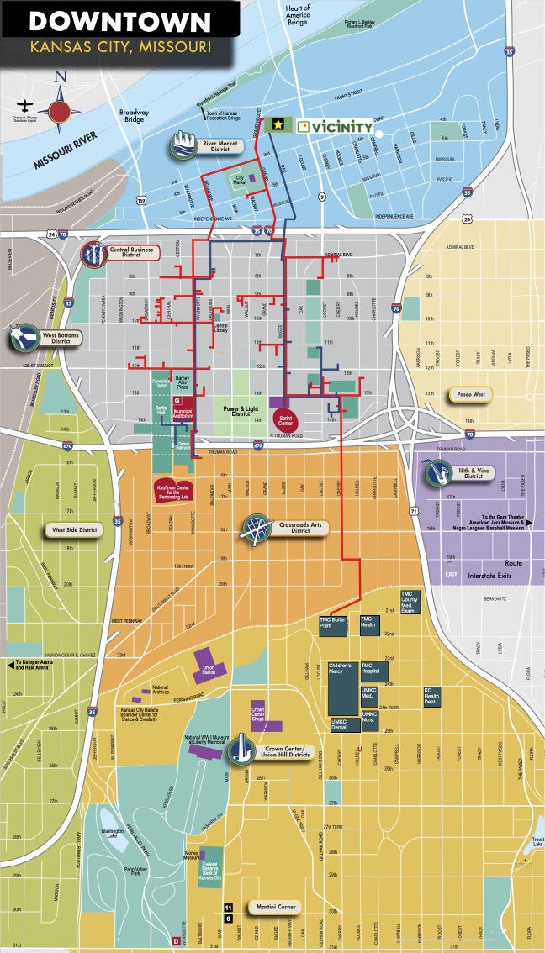
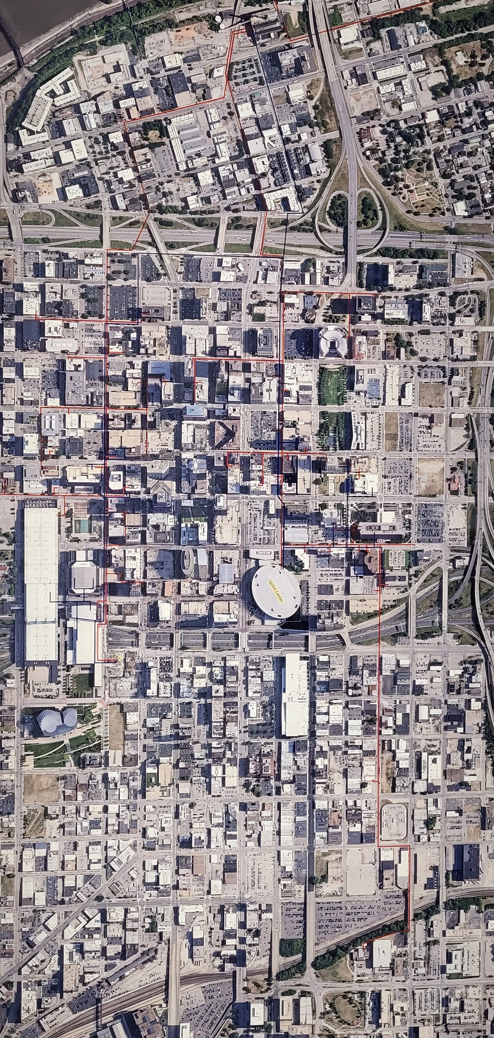
The Kansas City
Network

Slide 5
Vicinity Electrification Strategy and Execution Plan

Slide 6
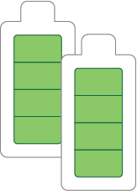
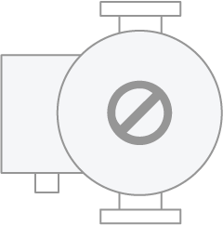
Vicinity is Electrifying…NOW
BOS Phase I decarbonization plan includes electric boilers, industrial-scale heat pumps, & thermal storage.
Electric Boilers
50 MW
Heat Pumps
10-50 MW
Thermal Storage
1,000 MWh
2021/22 –
50MW electric boiler (120,000 lb/hr)
  In final design
  Equipment being sourced
Filing process with ISO-NE in process
2023/24 –
Installation of electric boiler at Kendall Station
Connected to existing high-voltage transmission lines
Heating produced will be from net zero/renewable power
End state – up to 300 MWs of electric boilers
2021/22 –
3rd party design nearly complete
Issuing a request for proposal (RFP)
2023/25 –
Plan to install largest heat pump complex in MA
Use heat “lifted” from the Charles River to make steam
Dramatically reduces our carbon footprint in the near term
2021/22 –
Approved for Network Service with ISO-NE
ISO-NE interconnection in process
2024/27 –
Provide 1,000 MWh of storage
Mitigate cost and carbon content of electrical peaks by “peak shaving”
  Aligned with winter offshore wind peak
Dramatically lower cost of electrified steam, driving adoption

Slide 7
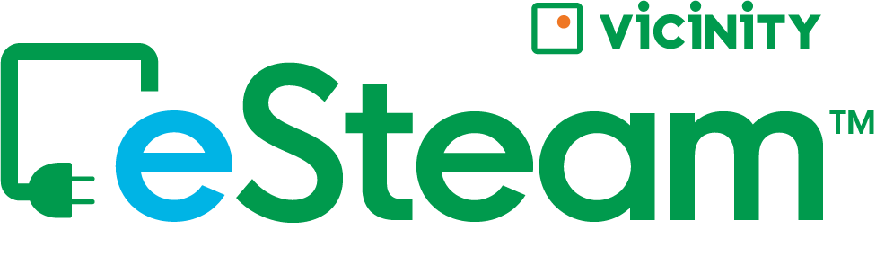
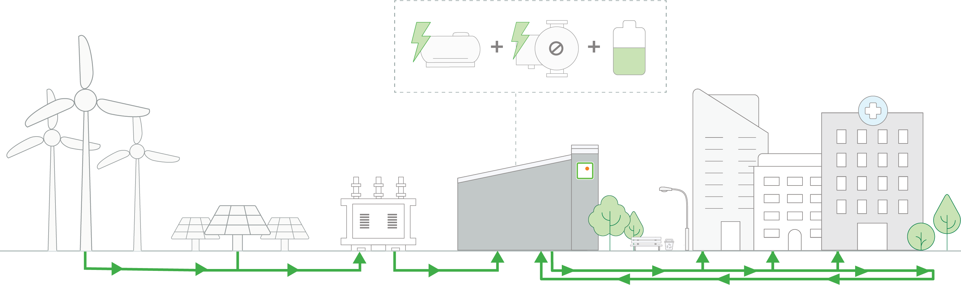

Vicinity’s eSteamTM … the future of district energy renewable thermal is emerging!
We are bringing renewable thermal and energy storage assets to our district energy systems
Leverage electric transmission interconnection to access wholesale market-priced renewable power
Convert renewable power to steam through highly efficient technologies at scale
Leverage existing status as wholesale grid customer to access real-time energy
Purchase of renewable power can be customer-controlled or Vicinity-supported
Customers can use Vicinity’s eSteamTM to achieve their net zero goals at their own pace
Physical
PPAs
RECs
EFECs
Electrification of district energy may be the easiest and most cost-effective path to net zero for center city buildings!

Slide 8

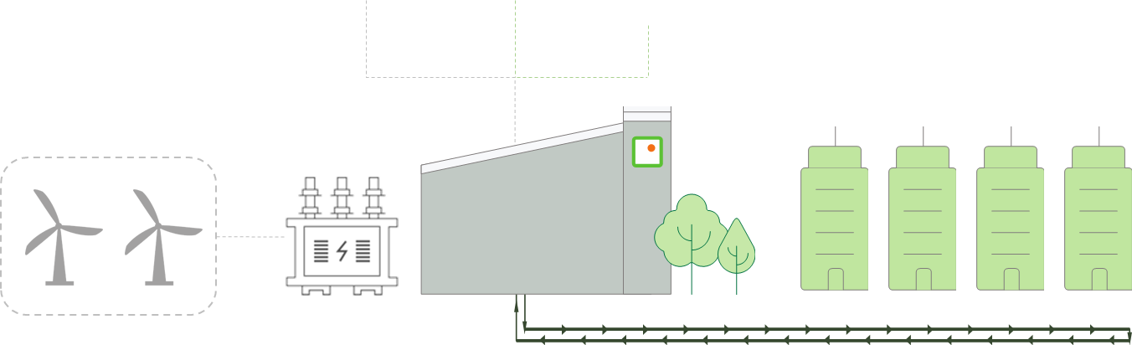
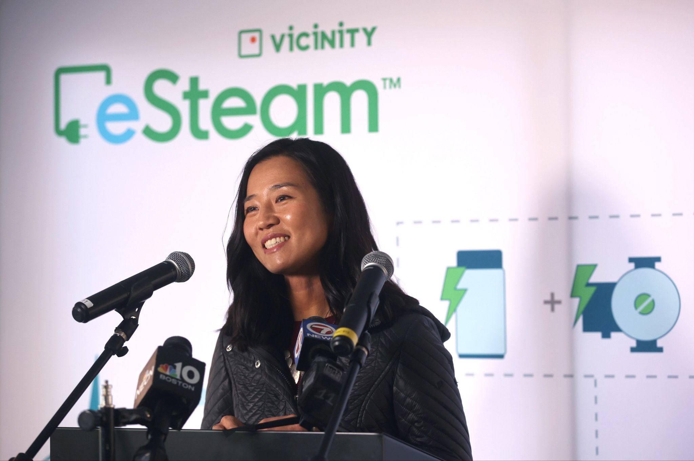
Providing Net Zero Carbon-free eSteam™ in Boston
Construction and engineering is underway for electric boilers, industrial-scale heat pumps and thermal storage
eSteam™ recognized as a carbon-free solution under Boston’s BERDO 2.0 regulation
  Renewable energy sources purchased in accordance with BERDO 2.0 standards
eSteam™ benefits:
  Save millions in costly retrofits and operating costs vs. other electrification alternatives
  Instantly receive carbon-free steam
  to achieve sustainability goals
  Same reliability and resiliency trusted by Boston’s largest mission-critical operations
Trusted by IQHQ, the first eSteam™ customer to sign up 2 buildings for carbon-free steam
Electric Steam Generation Boston Timeline
Electric Boilers
42 MW
2024
Heat Pumps
10++ MW
2025
Thermal Storage
1 GWh
2025-2027
Carbon-free Renewable electricity
Transmission level rates
Carbon-free Thermal Energy Delivered to Customers
“It is remarkable to be able to say that Vicinity is the first energy company in the country to electrify its operations. That is a huge deal and one that will have ramifications for generations to come.” – Boston Mayor Michelle Wu

Slide 9
Questions
Contact: Matt O’Malley
(617)935-9752
Matthew.omalley@vicinityenergy.us

