Slide 1
PUBLIC WORKS

Slide 2
Truman Road Complete Streets
EMC
March 8th, 2023

Slide 3
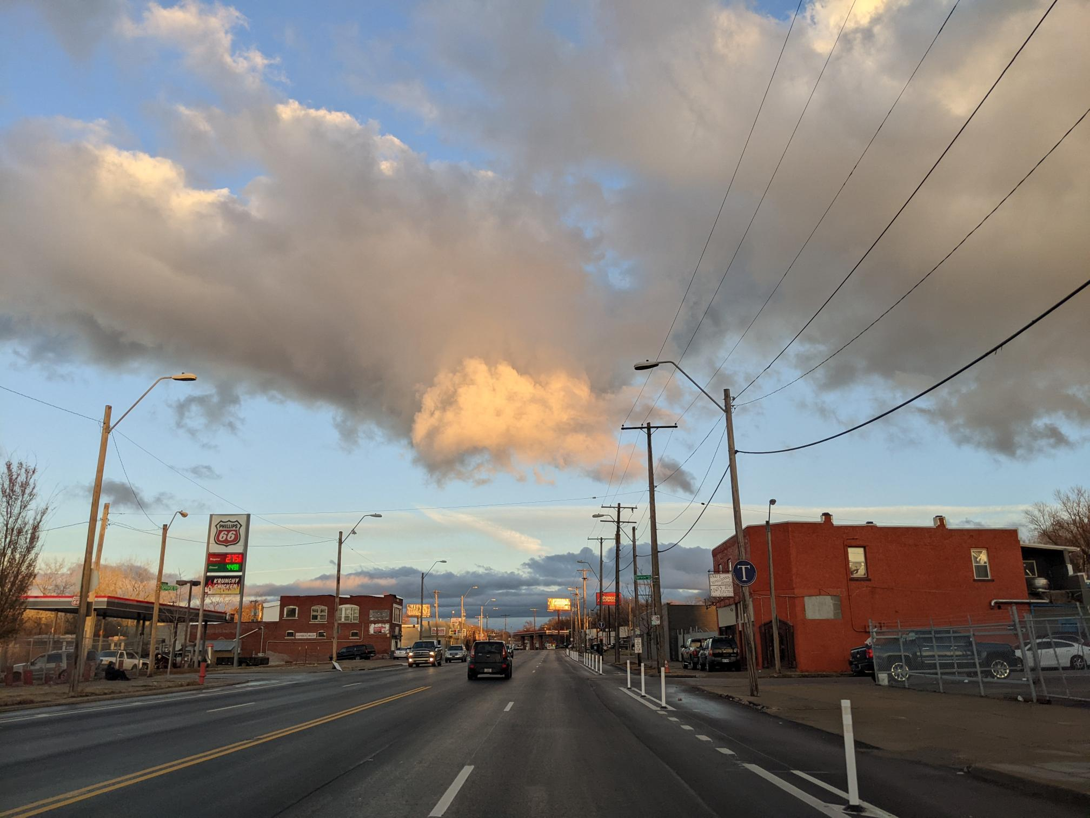
Agenda
PUBLIC WORKS
Project Background and Engagement
Proposed Changes
Cost
Issues raised and solutions proposed
Q&A

Slide 4
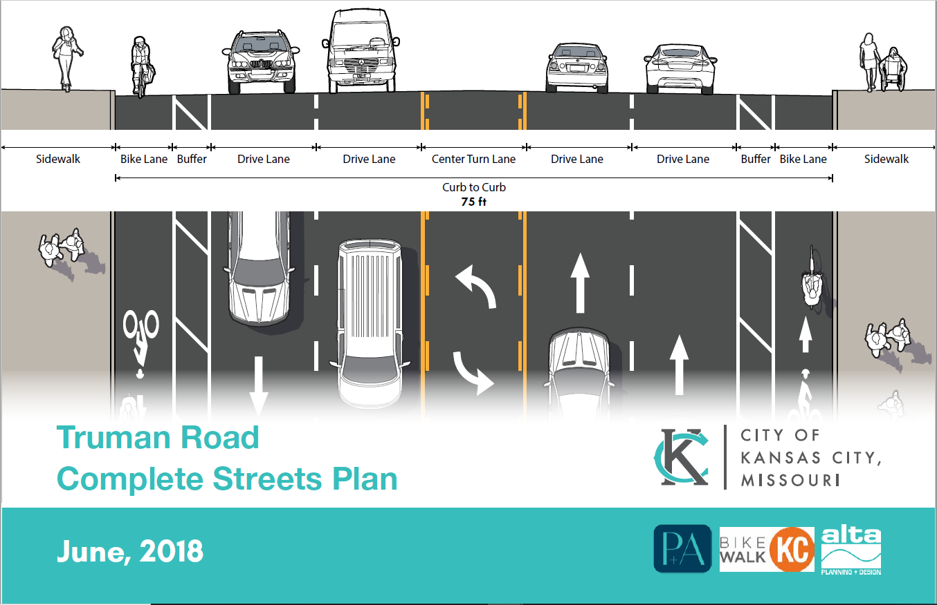
Project Background
PUBLIC WORKS
2018 Complete Streets PSP
High Injury Network
2015 – 2020: 360 Injury Crashes (Minor Injury, Serious Injury, Fatal)
2015 – 2020: 27 Crashes (Fatal and Serious Injury Only)
2022 Protected Bike Lane Program
Area Plan Recommendation
High Injury Network

Slide 5
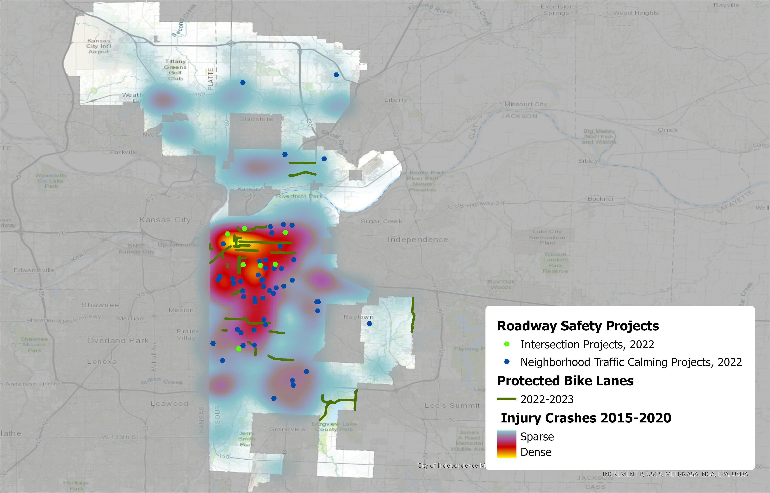
PUBLIC WORKS
Truman Rd Crashes – Holmes to Hardesty
 | Killed | Injuries | Total # of Crashes
2021 | 0 | 67 | 220
2022 | 3 | 78 | 202

Slide 6
Planning Sustainable Places
PUBLIC WORKS
Vision Statement
Truman Road is a safe, accessible, comfortable, and welcoming complete street corridor that supports all modes of transportation and serves as a catalyst for economic and community development.
Plan Goals
Goal 3: Support economic development through high quality public infrastructure that stimulates new development and supports a vibrant and lively corridor for area residents, businesses, employees, and visitors.

Slide 7
Other Plan Recommendations
PUBLIC WORKS
Greater Downtown Area Plan (2019)
Road Diet on Truman Rd
Replace with bike facility/parking/ped facilities)
Improve Pedestrian Crossing on Truman Rd
Implement road diets and improve bikeability in conjunction with streetscape enhancements
Truman Plaza Area Plan (2012)
Pursue traffic calming
Heart of the City Area Plan (2011)
Support transit and Multimodal transportation
Prioritize pedestrian improvements
Prioritize transit improvements
Truman as “image” street

Slide 8
Public Works
Truman Road Engagement Log - from 2017-2022
 |  | Location | Address
10/5/2017 | Stakeholder Meeting - Manual Career & Technical Center | Manual Career & Technical Center | 1215 E Truman Rd
10/5/2017 | Stakeholder Meeting - Walker Uniform | Phone | 2601 E Truman
10/6/2017 | Stakeholder Meeting - Missouri Sewing Machine | 1011 E Truman | 1011 E Truman
10/6/2017 | Stakeholder Meeting - Commuter | Truman Rd | Ivanhoe Neighborhood
10/10/2017 | Stakeholder Meeting - OK Furniture | OK Furniture | 2522 E Truman Rd
10/10/2017 | Stakeholder Meeting - U.S. Post Office - James Crews Location | U.S. Post Office | 2201 E Truman Rd
10/10/2017 | Stakeholder Meeting - C&S Wood Shop | C&S Wood shop | 2101 E Truman
10/10/2017 | Stakeholder Meeting - Guadalupe Ceters | Guadalupe Centers | 5125 E Truman
10/11/2017 | PSP Advisory Committee #1
10/16/2017 | Stakeholder Meeting - 23rd St PAC Neighborhood | Providence Church | 1925 Hardesty
11/8/2017 | PSP Community Meeting #1 | Manual Career & Technical Center | 1215 E Truman Rd
12/18/2017 | PSP Advisory Committee #2 | Virtual
3/21/2018 | PSP Community Meeting #2 | Gregg Klice Community Center | 1600 John Buck O'Neil Way
3/22/2018 | PSP Advisory Committee Meeting #3 | Gregg Klice Community Center | 1600 John Buck O'Neil Way
4/4/2022 | Notification Mailer sent out to businesses | all 200 addresses along Truman Rd from Holmes to Hardesty
4/11/2022 | Virtual Public Meeting | Microsoft Teams
4/12/2022 | Virtual Public Meeting | Microsoft Teams
4/20/2022 | TI&O City Council Committee | Council Chambers
12/15/2022 | Truman Rd CID meeting | Kenton Brothers | 3401 E Truman Rd

Slide 9
2022 PBL Engagement
Public Works
Public Notice Mailer
Sent to properties along Truman Rd
200 properties
Mailed out on 4-4-2022
Public Meetings
4-11-2022 6 pm – 7 pm Virtual Public Meeting
4-12-2022 12 pm - 1 pm Virtual Public Meeting
City Council Approval
PBL Year 1 & 5-Year networks approved by City Council (4/20/22)
Notes:
See “Truman Rd Mailer address list” for list of addresses
See “PBL Year 1 Public Notification Letter-4-4-22” for what was mailed

Slide 10
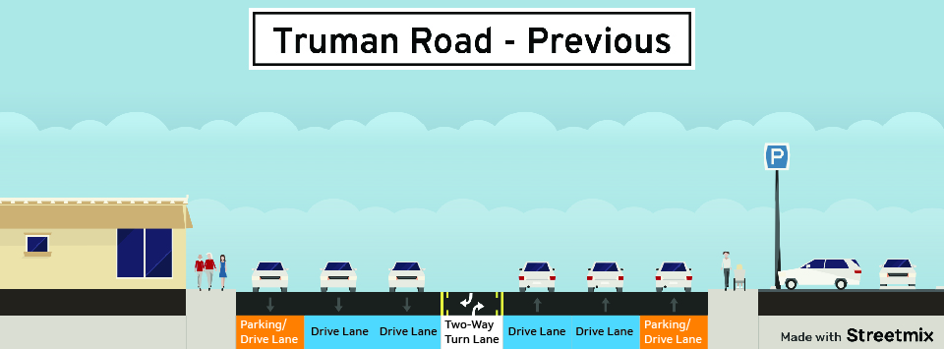
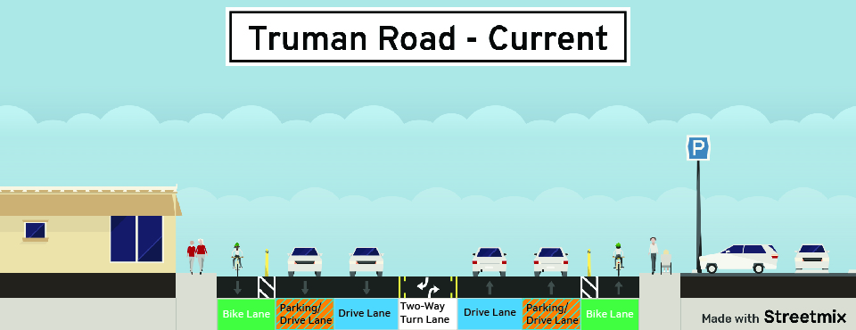
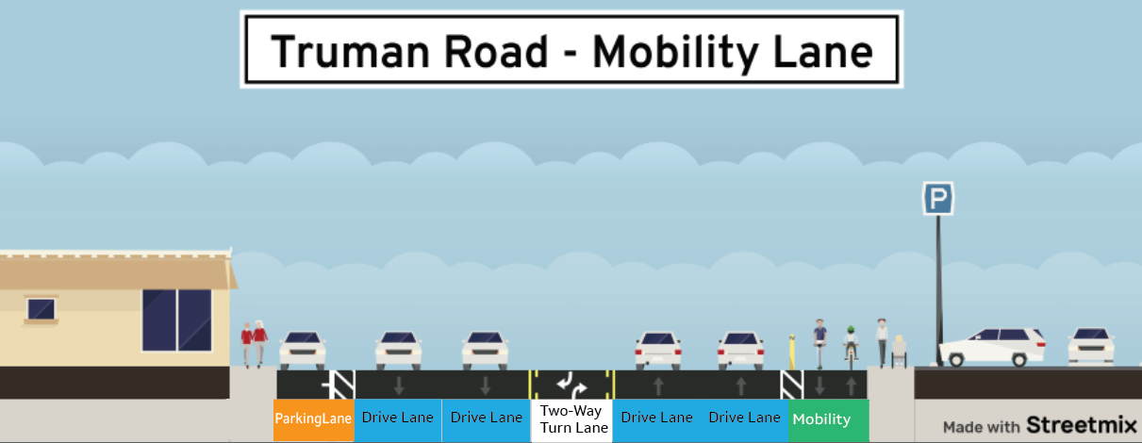
PUBLIC WORKS
Previous Condition
Six Lanes of Travel
Peak Hour Restricted Parking
Center Turn Lane
Current Condition
Four Lanes of Travel
Peak Hour Restricted Parking
Center Turn Lane – in places
Protected Bike Lanes
Proposed Condition
Four Lanes of Travel
Permanent Parking on North side
Center Turn Lane – in places
Mobility Lane on South side of street

Slide 11
Cost
PUBLIC WORKS
Initial Installation*
Mobility Lane conversion
Pavement Markings + Delineators + Parking Stops:
$751,310.26
*installation NOT completed
Pavement Markings + Delineators + Parking Stops:
$442,408.20

Slide 12
Cost
PUBLIC WORKS
Project | Elements | Cost | Notes
Initial Project | Pavement Markings + Delineators + Parking Stops | $751,310.26 | NOT finished
Mobility Lane on South Side | Pavement Markings + Delineators + Parking Stops | $442,408.20 | Mobility Lane on South side and Parking Lane on north side
Install Protected Parking | Make Parking Lane Permanent | $327,940.50 | Protects a Parking Lane against existing bike lanes

Slide 13
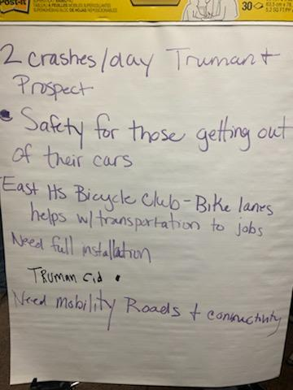
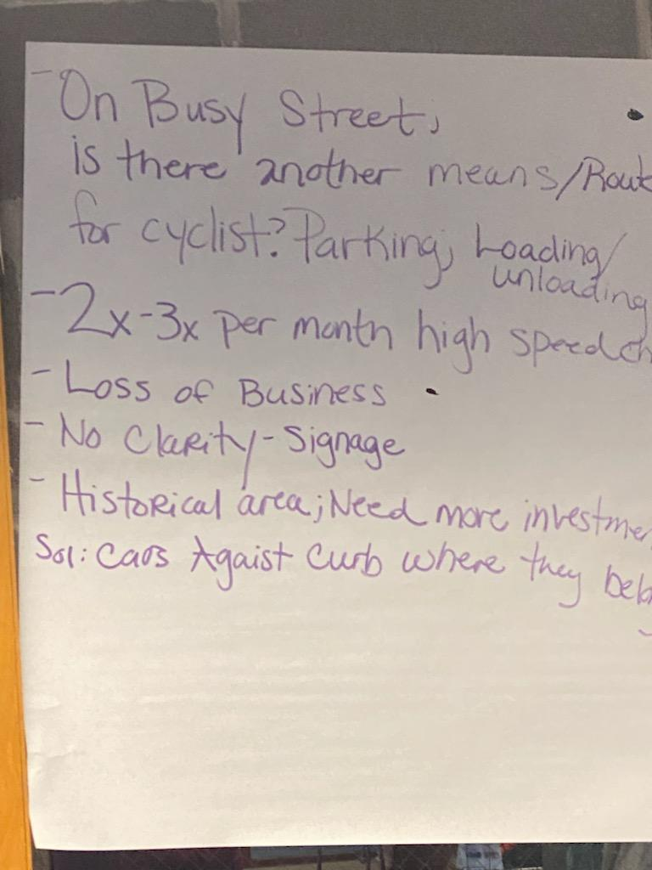
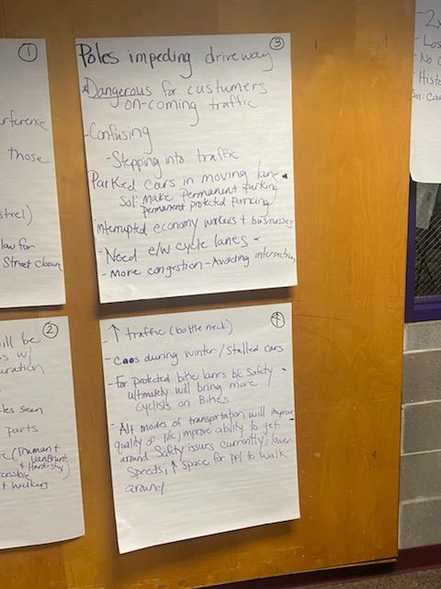
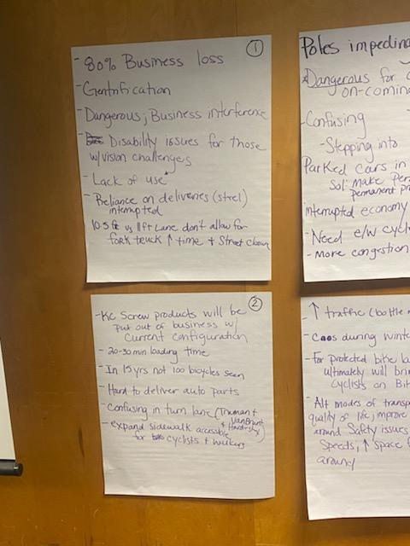
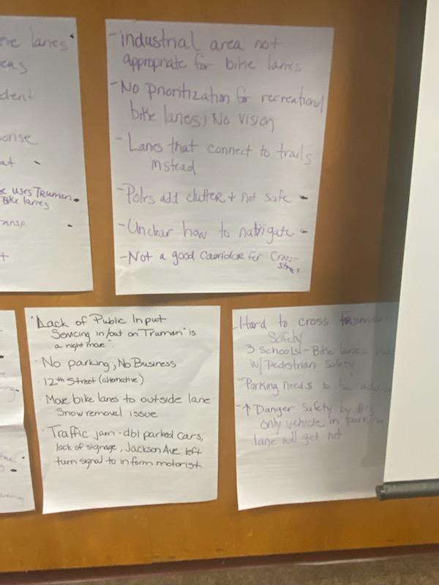
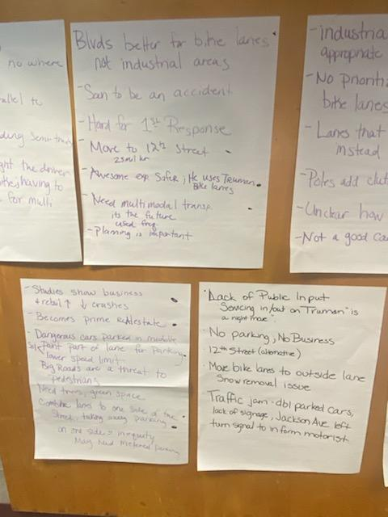
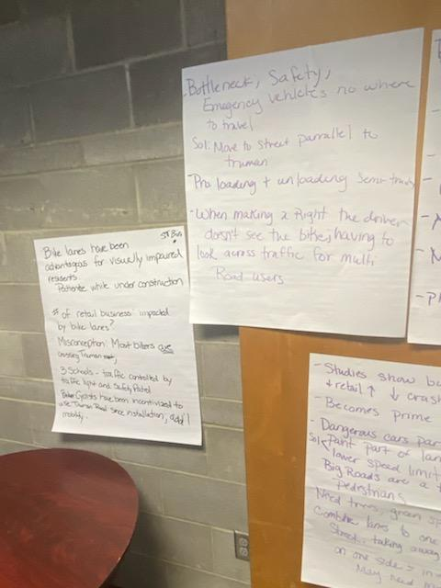
PUBLIC WORKS
January 6th Meeting

Slide 14
Categories of Issues Raised at 1/6 Meeting
PUBLIC WORKS
Safety Issues from New Roadway Design
Traffic Operations
Parking
Land Use Access
Business/Economy
Snow/Emergency Operations
Issues with Previous Roadway Design
Other
Positives
Solutions/Suggestions
Process Issues

Slide 15
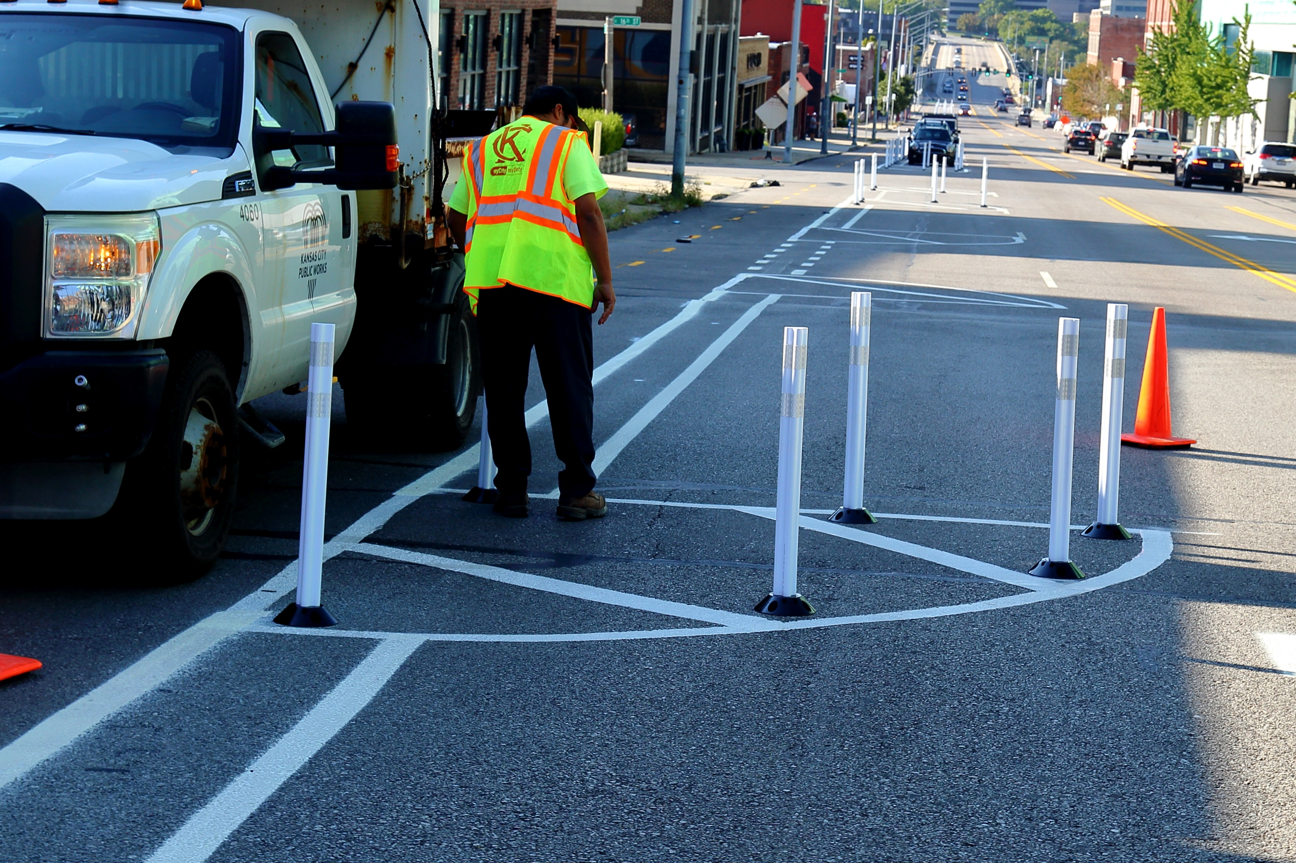
Solution: Mobility Lane
PUBLIC WORKS

Slide 16
Questions and Comments
PUBLIC WORKS

Slide 17
Thank you!
PUBLIC WORKS
Please direct further questions and comments to:
bailey.waters@kcmo.org
bobby.evans@kcmo.org

Slide 18
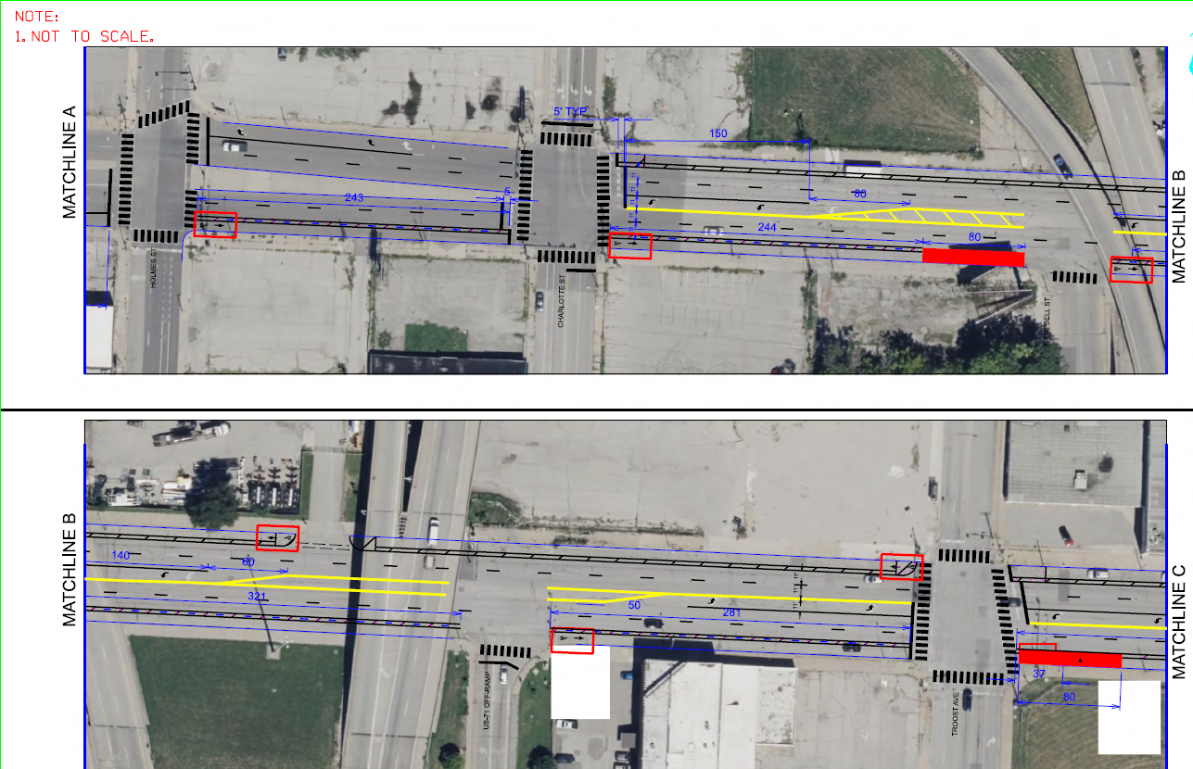

Slide 19
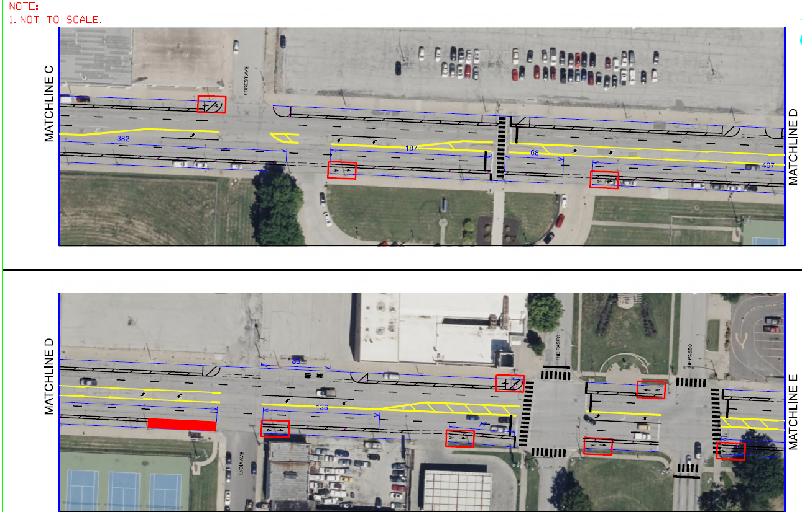

Slide 20
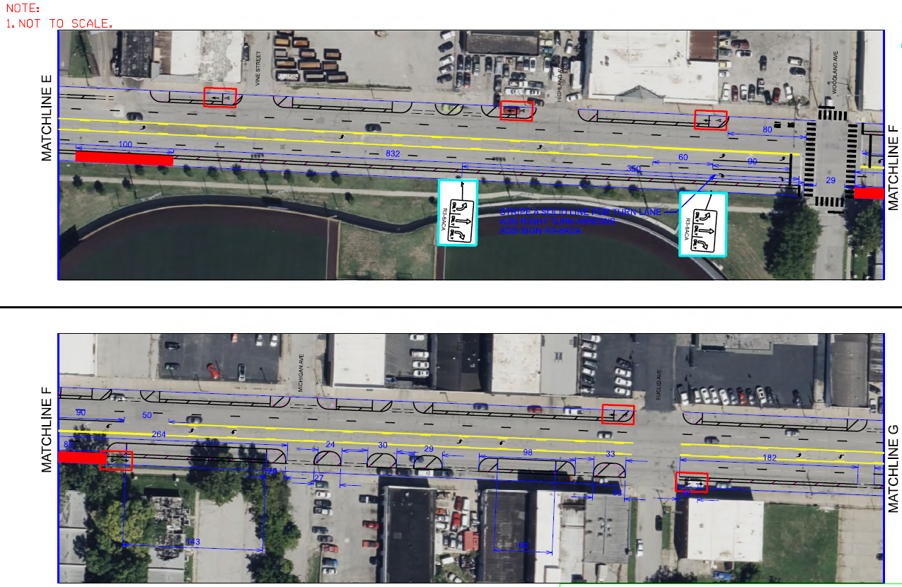

Slide 21
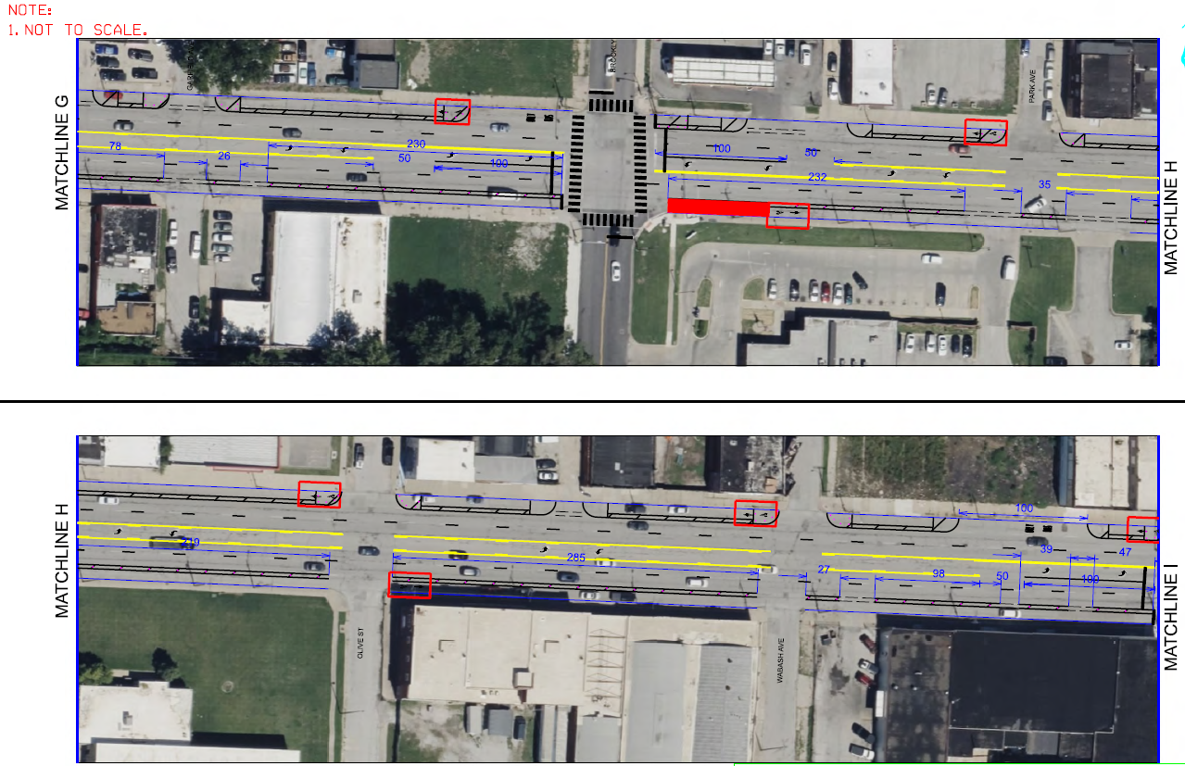

Slide 22
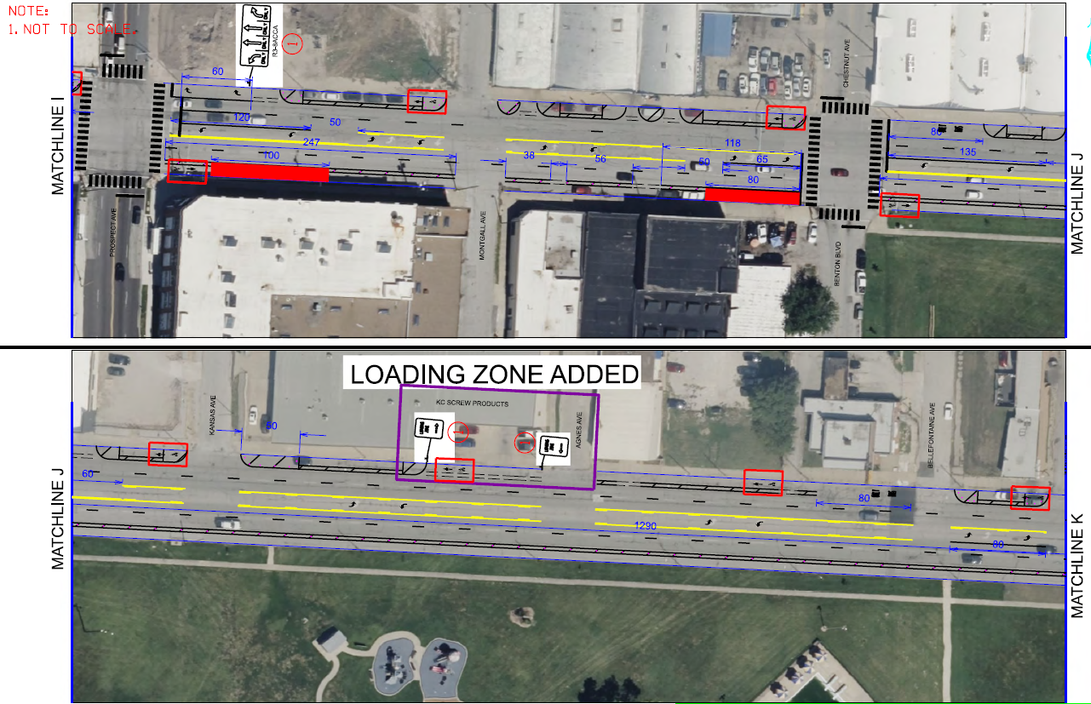

Slide 23
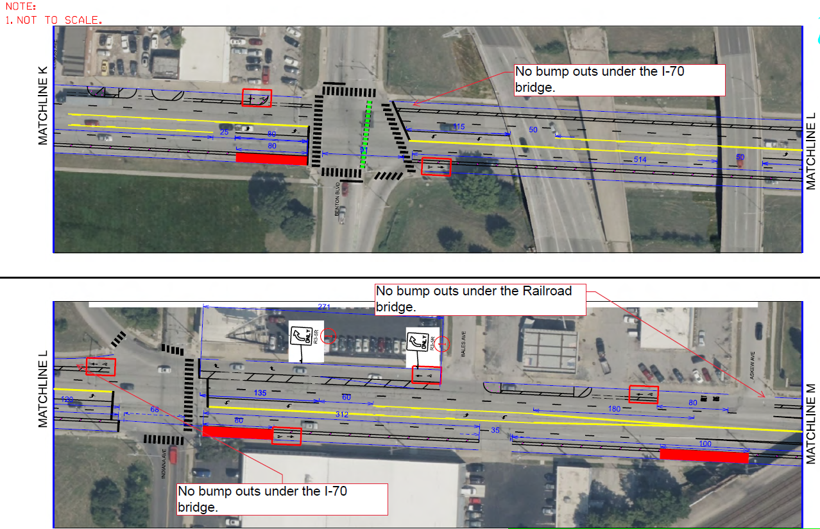

Slide 24
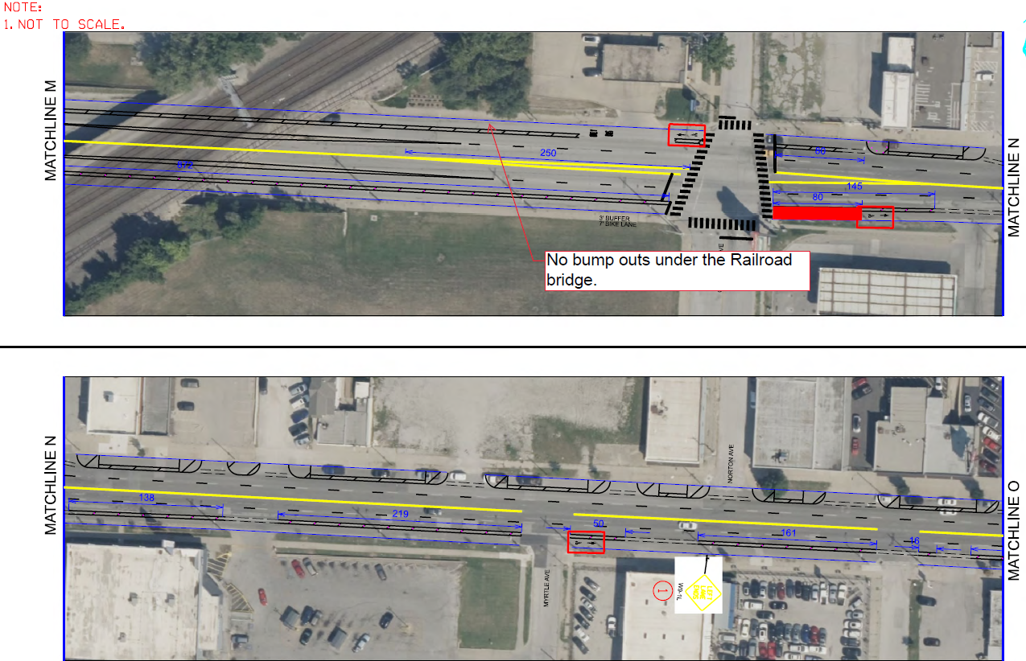

Slide 25
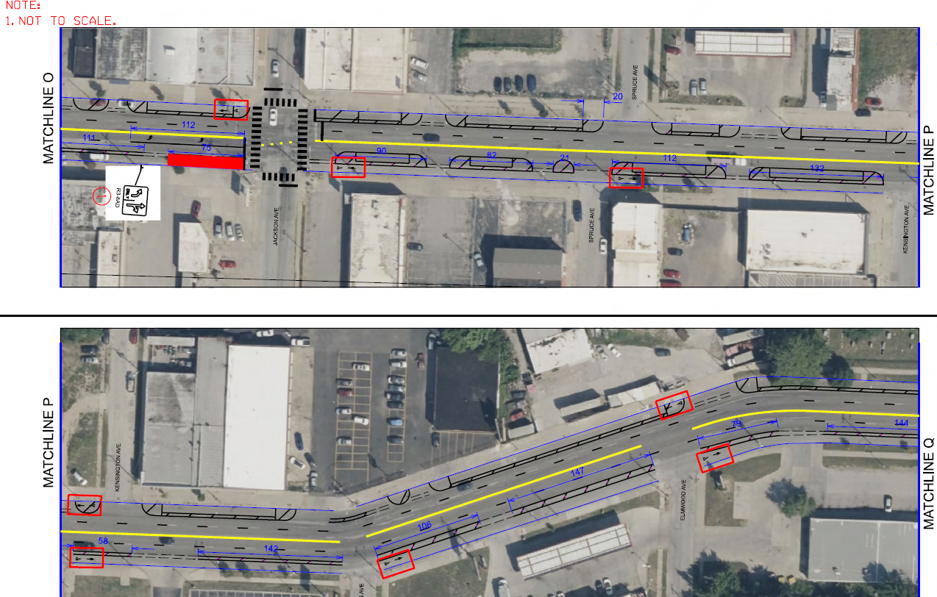

Slide 26
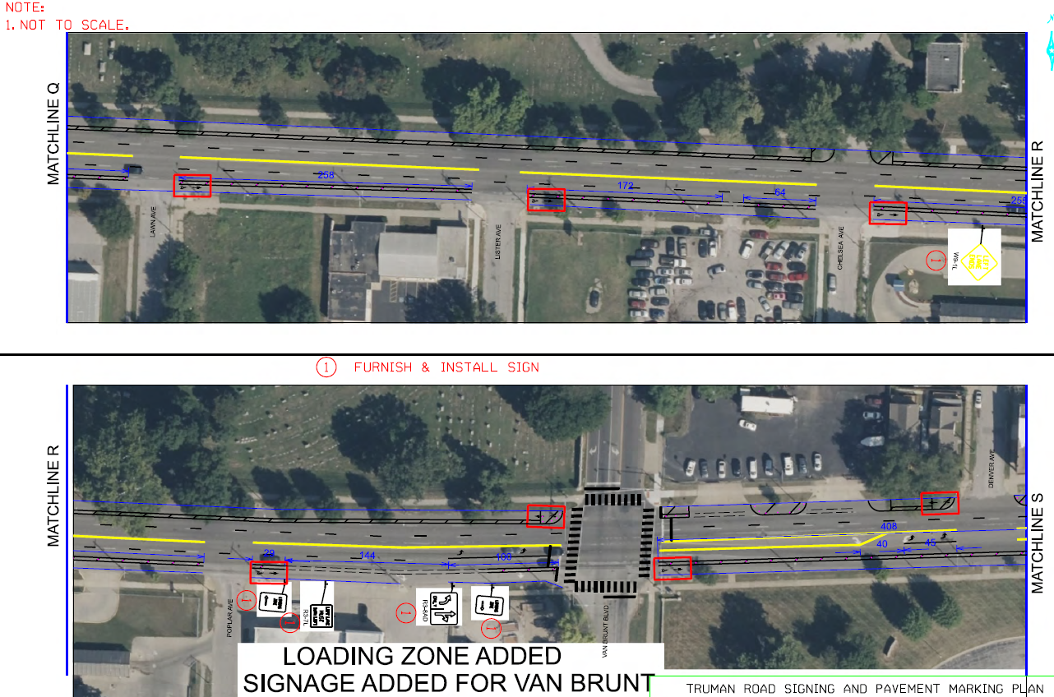

Slide 27
PUBLIC WORKS

