Slide 1
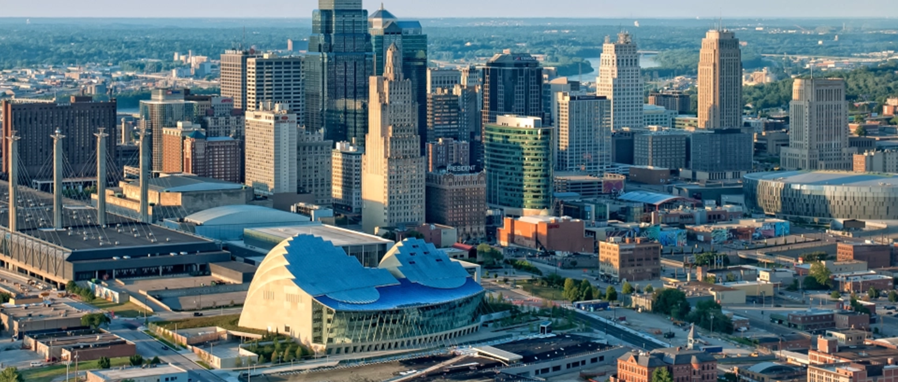
Ordinance No. #210088 Climate Plan Update
February 3, 2021

Slide 2
Climate Protection Plan
Developed as a foundation for making sustainability a key principle in municipal operations
Created with input from diverse group of stakeholders
Because of efforts associated with this plan, Kansas City was able to reduce its greenhouse gas emissions, as of 2017:
40% below year 2000 levels for city operations
21% below year 2000 levels for community-wide emissions
Adopted in 2008 - Short term goals expired in 2020
Plan did not directly address adaptation to climate events or carbon sequestration

Slide 3
Resolution No. 200005
Adopted May 2020
Crafted with assistance and input from environmental stakeholders
Set new more ambitious greenhouse gas reduction goals
Climate Plan to include climate adaptation and carbon sequestration strategies
Requires an equitable and transparent planning process
GHG Reduction Targets | Community Wide | City Operations
2008 Climate Plan Goals | 30% by 2020 with 2000 baseline | 30% by 2020 with 2000 baseline
2008 Climate Plan Achieved | 21% as of 2017 GHG Inventory | 40% as of 2017 GHG Inventory
Resolution# 200005 Adopted 2020 Updated baseline to 2005 | 30% by 2025 50% by 2030 with 0% from electricity Carbon Neutral 2040 | 0% from electricity by 2022 70% by 2025 Carbon Neutral 2030

Slide 4
Kansas City’s Carbon Footprint
Carbon Footprint: The total amount of greenhouse gases that are generated by our actions.
To have the best chance of avoiding a 2°C (3.6°F) rise in global temperatures, the average global carbon footprint needs to drop to under 2 tons per person per year by 2050.
As of 2017, Kansas City was at 18.2 tons per person, per year.
Source: KCMO 2017 GHG Inventory and Worldbank.org

Slide 5
Updating the Climate Plan to address ongoing and emerging issues of equity and resiliency
Mitigation
Limit the causes of climate change
Adaptation
Limit the effects of climate change
Sequestration
Remove CO₂ from the atmosphere

Slide 6
Consultant Team
Lead Contractor: Based in Fort Collins, CO
20+ years of Climate Planning, Community Planning, and Community Outreach experience
75% of Project Budget
Subcontractor: Based in Kansas City, MO
20+ years of Equity, Community Engagement, and Community Revitalization experience
20% of Project Budget
5% of project budget to hire local interns to assist with the project and build local experience in equitable climate work

Slide 7
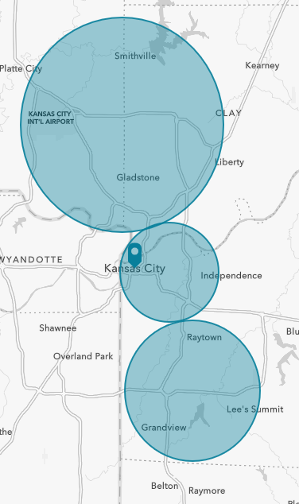
Project Approach
Phase 1: Listen and Learn
Phase 2: Collaborate and Explore
Understand the context in which this plan is taking place including racial disparities, socioeconomic conditions, community vulnerabilities, political and regulatory landscape, and previous climate mitigation and resiliency efforts.
Use the information collected in Phase 1 to begin gathering ideas from community members, stakeholders, and City staff about potential solutions and actions for climate resiliency and mitigation in Kansas City.
Phase 3: Prioritize and Align
Phase 4: Mobilize
Use identified community needs, technical expertise, and analysis outcomes to identify the solutions with the highest potential for impact to drive the City to meet is climate goals.
Create the tools and resources needed to support successful implementation of the ideas outlined in the Climate Protection and Resiliency Plan.

Slide 8
Climate Action Planning
Process and Schedule
CRVA & GHG Inventory
Outreach/Equity Plan
Gather GHG Data
Draft Climate Protection & Resiliency Plan
Community Education
Plan Implementation
Community Involvement
Final Climate Protection & Resiliency Plan
Public Comment
Workgroup Feedback
Community Involvement
Stakeholder Involvement
Consultant Selection
Proposal Review
Council Approval
Gather CRVA Data
Consultant Selection
We Are Here
Fall 2020 ---- Winter 2020 --- Spring 2021 --- Summer 2021

Slide 9
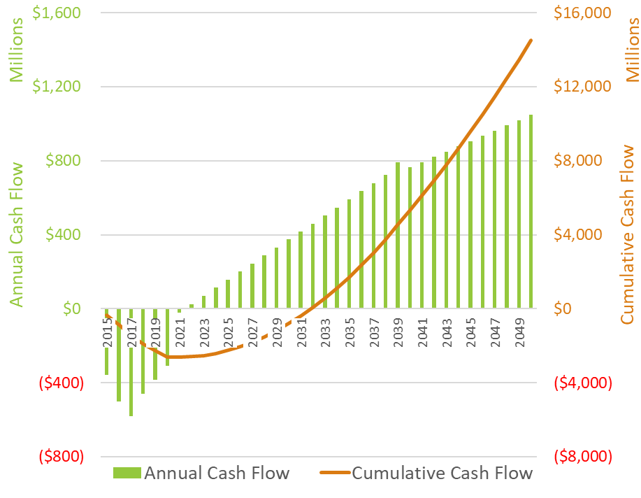
Project Deliverables
Task 1: Engagement and Outreach
Equity and Outreach Plan
Climate Team Work Sessions
Community workshops
Task 2: Data Analysis
Community Vulnerability Assessment
Greenhouse Gas Inventory & Forecast
Metrics and Maps
Adaptation and Resiliency Approach
Task 3: Climate Plan
Climate Protection and Resiliency Plan
Implementation Framework
Task 4: Implementation Resources
Climate action tracking
Communications and Engagement Toolkits
Annual Reporting Template
Financial and Resource Analysis
Partnership and Funding Options
Example Return on Investment Scenario

Slide 10
ORDINANCE NO. 210088
Contract No. EV2793 with Brendle Group, Inc for $150,000 to develop a comprehensive, equitable, innovative, and multisector Climate Protection and Resiliency Plan that is capable of achieving or exceeding the greenhouse gas emission reduction targets within the dates set forth in Resolution No. 200005

Slide 11
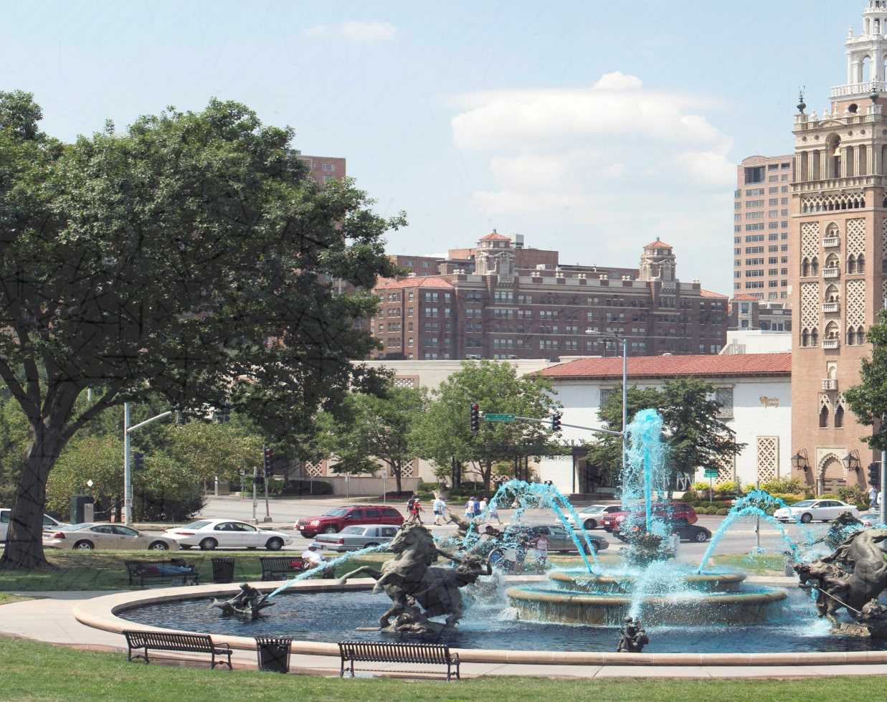
Questions?
Andy Savastino
Chief Environmental Officer
Office of Environmental Quality
Lara Isch
Sustainability Manager
Office of Environmental Quality

