Slide 1
KANSAS CITY, MISSOURI EARNINGS TAX
Overview
Tammy Queen, Director of Finance
City of Kansas City, Missouri

Slide 2
What is the earnings tax?
One percent (1%) tax on the earnings of individuals and businesses
Applies to:
All City residents regardless of where they work
Nonresidents working within the City limits
Businesses located in Kansas City or doing business in Kansas City
Three components
Withholding
Wage Earner
Profits

Slide 3
Who pays the earnings tax?

Slide 4
Application of the Earnings Tax
What is taxable?
Wages and salaries of individuals who live or work in Kansas City
Net profits of businesses and the self-employed doing business in Kansas City
What is not taxable?
Dividends
Interest
Pensions, IRAs, other retirement income
Social security
Unemployment benefits
Workers’ compensation
Disability payments

Slide 5
History of the Earnings Tax
1963
Earnings tax approved at a rate of 0.50%
1970
Earnings tax rate increases to 1%
2010
Proposition A* passes in Missouri
2011
Earnings tax renewal was upheld - 77% in favor
2016
Earnings tax renewal was upheld - 78% in favor

Slide 6
Earnings Tax Rates - Comparison
City | Earnings Tax Rate | City | Earnings Tax Rate
Philadelphia, PA* | 3.8712/3.5019% | Portland, OR | 2.20%
Pittsburg, PA* | 3.00/1.00% | Cleveland, OH | 2.00%
Detroit, MI* | 2.4/1.2% | Indianapolis, IN* | 1.77/.4425%
Lexington, KY | 2.25% | St. Louis, MO | 1.00%
Louisville, KY* | 2.20/1.45% | Kansas City, MO | 1.00%

Slide 7
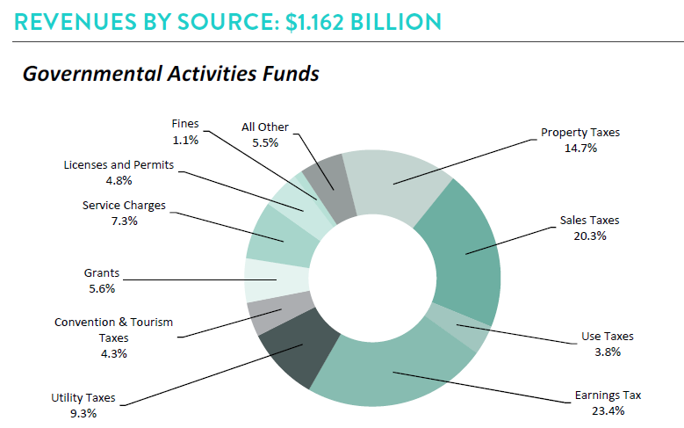
Earnings tax is the single largest revenue source in the City’s budget

Slide 8
Earnings Tax
No restrictions on uses of funds
FY 2020-21 Adopted Budget
Revenue estimate: $292.3 M
Redirections: 7.1%
45% of General Fund revenues
Public Safety = 73% of General Fund expenditures

Slide 9
Earnings Tax - Growth

Slide 10
What does the earnings tax support in Kansas City?
Fire protection
Police
Trash collection
Health care programs
Dangerous buildings removal
Environmental quality
Street repairs
Debt service
Weed control
Affordable housing

Slide 11
KCMO Regional Assets
American Jazz Museum
Negro Leagues Baseball Museum
Liberty Memorial
Kansas City Museum
Bartle Hall and Convention Center Complex
T-Mobile Center

Slide 12
KCMO Shared Services/Support
Regional Police Academy
Police Helicopter Unit
Regional Computer Forensics Laboratory (RCFL)
Emerging Threats Analysis Capability (ETAC)
K-9 Unit
Bomb and Arson Squad
Tactical Response Teams
Metropolitan Police Squad (Metro Squad)
Homeland Security
Public Safety Radio Communications
Regional Fusion Center
Law Enforcement Resource Center
High Intensity Drug Trafficking Areas (HIDTA) Program
Narcotics and Vice Task Forces
Kansas City Crime Commission

Slide 13
April 6, 2021 Election
Authorized by Ordinance No. 200854
To continue Kansas City’s current one-percent earnings tax for five years beginning January 1, 2022
If not approved:
Tax would be phased out over 10 years
City would be prohibited from enacting a new earnings tax

Slide 14
Options for Replacing the Earnings Tax

Slide 15
E-Tax Replacement Scenario #1 – Sales Tax
The earnings tax is not fully replaceable with state-authorized, but not voted, sales taxes many of which are for limited purposes.
Available sales tax statutory authority includes:
1.00% - General
0.25% - Capital Improvements
0.125% - Transportation
0.375% - Economic Development
Existing 3.25% tax rate would need to be 6.25%
Requires new statutory authority and local voter approval

Slide 16
E-Tax Replacement Scenario #2 – Property Tax
The earnings tax is not fully replaceable with authorized, but not levied, property taxes:
General purpose levy would have to be increased – but that wouldn’t be enough
Requires voter approval
Full replacement requires current levy to be nearly tripled to approximately $4.6688 per $100 of assessed valuation *
Requires new statutory authority and local voter approval
For a property owner owning automobiles with a market value of $35,000 and a home with a market value of $200,000, annual City property taxes would increase by 193% or $1,526 per year

Slide 17
Potential Impacts of Earnings Tax Loss
Major increases in other taxes beyond current state authorizations which are for limited purposes
Major reductions in core city services
Disrupts long-term contractual agreements
Debt instruments
Economic development deals
Increases risk profile:
Budget
Service Delivery
Credit

Slide 18
Credit Rating Implications
Current general obligation credit ratings:
AA – Standard and Poor’s – stable outlook
Aa2 – Moody’s – stable outlook
Possible downgrade
Reduced/limited access to credit
Increased cost of capital
Periodic renewal requirement adds credit risk
State legislative priority to lengthen time between required elections from five years to ten years

Slide 19
Questions?

