Slide 1
Missouri Bills SB230 / HB488
Briefing for Kansas City Environmental Management Commission
March 10, 2021
Billy Davies, Sierra Club Missouri Chapter

Slide 2
Agenda
Quick look at the text
Background and what these bills are about
Where legislation stands now
Possible next steps

Slide 3
Text
Under this act, no political subdivision shall adopt an ordinance, resolution, regulation, code or policy that prohibits, or has the effect of prohibiting, the connection or reconnection of a utility service based upon the type or source of energy to be delivered to an individual customer.
Nothing in this section shall limit the ability of a political subdivision to choose utility services for properties owned by such political subdivision.
Notes:
In the Senate sponsored by Sen. Burlison. Supported by Spire, gas companies, some trade unions, and industry advocates.

Slide 4
Text
Under this act, no political subdivision shall adopt an ordinance, resolution, regulation, code or policy that prohibits, or has the effect of prohibiting, the connection or reconnection of a utility service based upon the type or source of energy to be delivered to an individual customer.

Slide 5
Some Background
Methane a potent greenhouse gas and contributor to climate crisis. Increased understanding of benefits of electrification and reducing use of fossil fuels.
Climate action a ahead of and during 2020 presidential election and now a national priority for the President.
Cities adopting climate action plans, new building codes to reduce pollution and GHG emissions, including policies to incentivize/require building electrification.
(February, 2020) preemption legislation passed by Arizona legislature in response to efforts by City of Flagstaff to implement climate plan.
Notes:
Nationwide effort by gas lobby. More information: https://www.npr.org/2021/02/22/967439914/as-cities-grapple-with-climate-change-gas-utilities-fight-to-stay-in-business

Slide 6
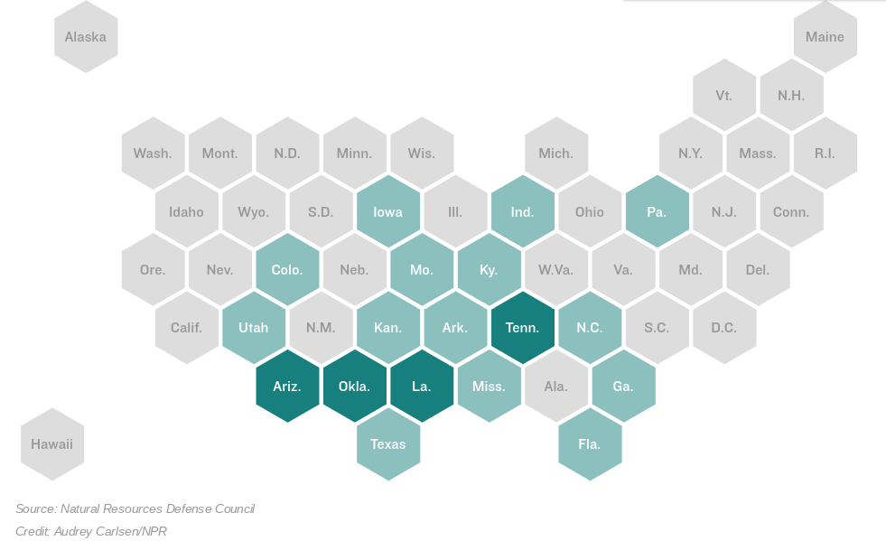
Notes:
To date, 4 states have passed legislation preempting cities from banning gas hookups and it is being considered by 14 others, including Missouri.
All legislation is virtually identical.

Slide 7
Goals of legislation
“Energy choice”
No jurisdiction in Missouri has proposed banning gas hookups
St. Louis
Other States
California: many cities taking action to limit gas use in homes
Salt Lake City: offering incentives
Denver: trying to electrify most buildings by 2027
Notes:
Nationwide effort by gas lobby. More information: https://www.npr.org/2021/02/22/967439914/as-cities-grapple-with-climate-change-gas-utilities-fight-to-stay-in-business

Slide 8
Goals of legislation
“Energy choice”
No jurisdiction in Missouri has proposed banning an energy source
Other States
California: many cities taking action to limit gas use in homes
Salt Lake City: offering incentives
Denver: trying to electrify most buildings by 2027
Notes:
Nationwide effort by gas lobby. More information: https://www.npr.org/2021/02/22/967439914/as-cities-grapple-with-climate-change-gas-utilities-fight-to-stay-in-business

Slide 9
Impacts (for MO or any state)
Definitely prohibited
Any city/county requires all new buildings within its jurisdiction to use electric-only for heating and cooking.
?
Adopting incentives for building electrification?
Adopting stronger building codes aimed at safeguarding health and increasing energy efficiency?
Setting a goal of reducing greenhouse gas emissions?
Notes:
Nationwide effort by gas lobby. More information: https://www.npr.org/2021/02/22/967439914/as-cities-grapple-with-climate-change-gas-utilities-fight-to-stay-in-business

Slide 10
Current Standing & Next Steps
Both pieces of legislation have been passed out of committee.
Senate Bill 230 passed 10-0 today.
House floor vote could be as early as this week. Senate floor vote not expected until after spring recess next week.

Slide 11
Assessment
These bills are aimed at a problem that does not exist in Missouri.
These bill could prohibit cities from making decisions about their future in a way that is responsive to the needs of their constituents, and regulatory uncertainty makes it harder for city officials to carry out their duties.
These bills ignore the potential for technological advancement currently underway by having no expiration date.

Slide 12
Potential Calls to Action
Missouri city leaders, stakeholders, and residents concerned should contact their Senators and representatives, as soon as possible.
Work with partners in business community.

Slide 13
Thank you.
Any questions?

