Slide 1
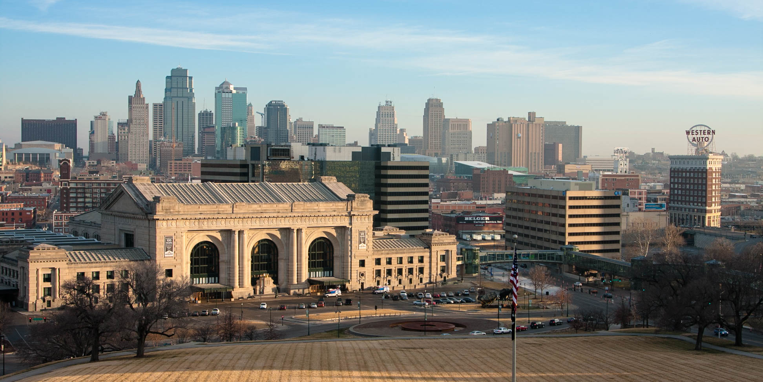
CLIMATE PROTECTION AND RESILIENCY PLAN

Slide 2
Climate Protection Steering Committee May 24, 2021
Agenda
Time | Item
3:00pm | Welcome and Introductions
3:10pm | Equity Briefing
3:30pm | Project Overview
3:40pm | Outreach and Engagement Plan: Phase 1
4:00pm | Questions and Discussion
Objectives
Meet the project team
Align on equity approach
Become oriented to the project
Collect feedback on Outreach and Engagement Plan: Phase 1

Slide 3
Welcome & Introductions

Slide 4
Meet the Consultant Team Leads
Judy Dorsey
Executive Project Manager
Becca Stock
Project Manager
Stephenie Smith
Equity Lead
Shelby Sommer
Engagement Lead

Slide 5
Introductions
Please share…
Your name
How long you’ve been on the CPSC
One past initiative you’d like to see highlighted in this plan
One goal you have for this plan

Slide 6
Equity Briefing

Slide 7
As We Get Started… Kansas City’s Commitment to Equity
Work with, not for!
Get proximate to the problem!
Attempt to change the narrative!
Be open to new information!
Be willing to be uncomfortable!
Commit! Engage! Trust the process!
No quick fix!
Maintain hope in the face of brutal facts!
Climate change does not impact everyone equally. Communities of color facing systemic racism, lower-income individuals, young children, the elderly, outdoor workers, immigrants, and refugees are often most severely impacted.
To discover where our community is today and where we would like to go, Kansas City commits to using these Equity Guiding Principles during the planning process.

Slide 8
Advancing Climate Equity
How Can We Do Better? Raise your “hand” or type in chat
How and where do disproportionate climate impacts show up in Kansas City?
Who has been overlooked or excluded by previous efforts?

Slide 9
Project Overview

Slide 10
What is the Kansas City Climate Protection and Resiliency Plan?
A roadmap to help the Kansas City community achieve its greenhouse gas emission reduction goals and adapt to the climate impacts we are already facing by:
 | Building on existing data and regional efforts |  | Gaining a deeper understanding of the challenges our neighborhoods are facing
 | Identifying neighborhood-specific solutions |  | Identifying roles, responsibilities, and resources to implement those solutions

Slide 11
Climate Action Planning in Kansas City
Kansas City adopts the Climate Protection Plan
2021-2022:
City staff hires Brendle Group and Sophic Solutions as the consultant team and works with community members to build a Climate Protection & Resiliency Plan
2008:
2020:
2040:
City Council directs staff to update the Climate Protection Plan to include new greenhouse gas reduction goals, resiliency, and equity
A carbon-neutral, equity-focused and resilient Kansas City

Slide 12
Outreach & Engagement Plan
Phase 1

Slide 13
Who are we engaging?
Climate Protection Steering Committee
Technical Advisors
Elected and Appointed Officials
Organizational Partners
Neighborhood Leaders
Public
Notes:
Technical Stakeholder Interviews
Technical stakeholders include City staff members and other primary community service providers that interface regularly with the City on climate-related matters.
Objectives are to learn and discuss previous and related climate action efforts, primarily in the areas of greenhouse gas emissions reduction, climate resiliency, and adaptation

Slide 14
How are we engaging?
Engagement Team
City staff and consultants
Responsible for implementation of Outreach and Engagement Plan
Conducting technical stakeholder interviews
Sharing Outreach Toolkit with organizational partners
Collecting feedback through KC Spirit Playbook online engagement platform
Updating CPSC, City Council, and other key bodies
https://playbook.kcmo.gov/
Notes:
Technical Stakeholder Interviews
Technical stakeholders include City staff members and other primary community service providers that interface regularly with the City on climate-related matters.
Objectives are to learn and discuss previous and related climate action efforts, primarily in the areas of greenhouse gas emissions reduction, climate resiliency, and adaptation

Slide 15
How are we engaging?
Climate Justice Workers
Community organizers
Paid positions, Jun ‘20-Feb ’21
Responsible for leading Community Conversations and capturing community stories
Acts as community ambassador
Accepting applications now through Wednesday, May 26

Slide 16
How are we engaging?
Project Intern
College student
Paid position, Aug ‘20-Jan ‘21
Responsible for supporting engagement efforts and tracking and analyzing outcomes
Accepting applications now through Wednesday, May 26 (may extend deadline)

Slide 17
What are we asking? Phase 1
Phase 1: Listen & Learn (May - July 2021)
What climate change impacts are of greatest concern to residents and neighborhood?
How has climate change already impacted residents’ health, home, or lifestyle?
Who is most impacted by these changes?
How can we better connect and engage with those most impacted?
What has worked and not worked with respect to previous or existing climate action initiatives?
https://playbook.kcmo.gov/

Slide 18
What we’ve heard so far

Slide 19
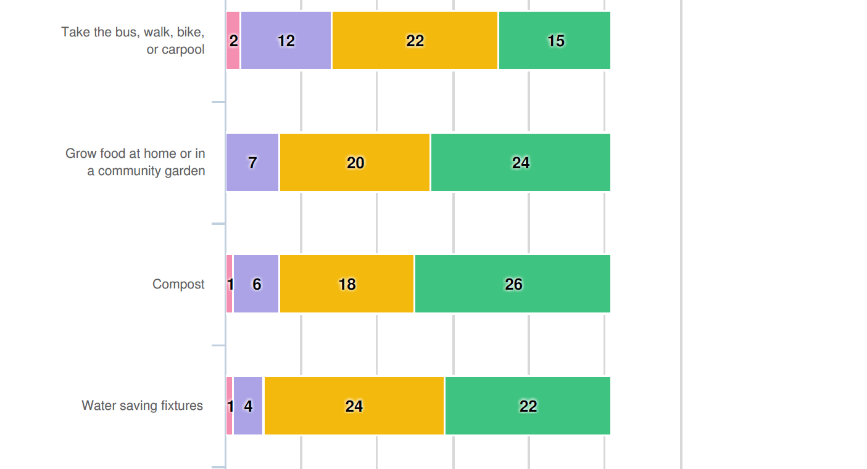
What we’ve heard so far

Slide 20
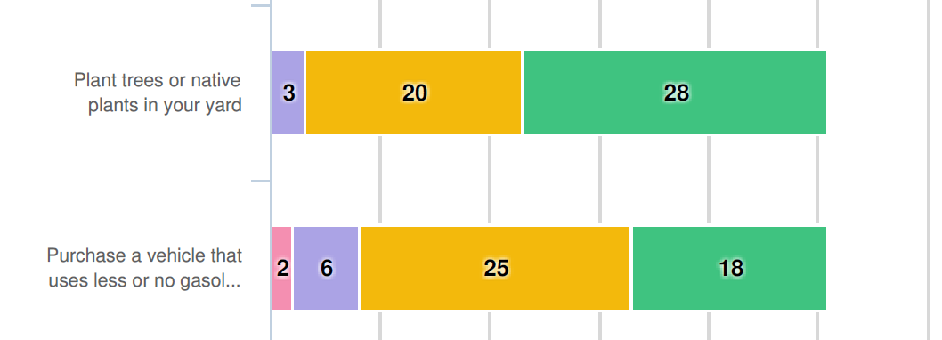
What we’ve heard so far

Slide 21
What are we asking? Future Phases
Phase 2: Collaborate & Explore (Aug. – Oct. 2021)
CPSC #2
What are your climate solutions for Kansas City?
How can we make your neighborhood more resilient?
Phase 3: Prioritize & Align (Nov. – Dec. 2021)
CPSC #3
Which climate solutions would be most helpful in your neighborhood?
What are your neighborhood’s top priorities?
Phase 4: Mobilize (Jan. – Feb. 2022)
https://playbook.kcmo.gov/
How can your neighborhood help implement these solutions?
Which key partners should be involved in implementing this plan?

Slide 22
Advancing Climate Equity
How Can We Do Better? Raise your “hand” or type in chat
Who is not well represented by the CPSSC?
Which community organizations do we need to connect with?
What new ideas do you have for equitable climate action engagement?

Slide 23
Questions?

